Slide 1
CAD Tools
Synopsys and Cadence

Slide 2
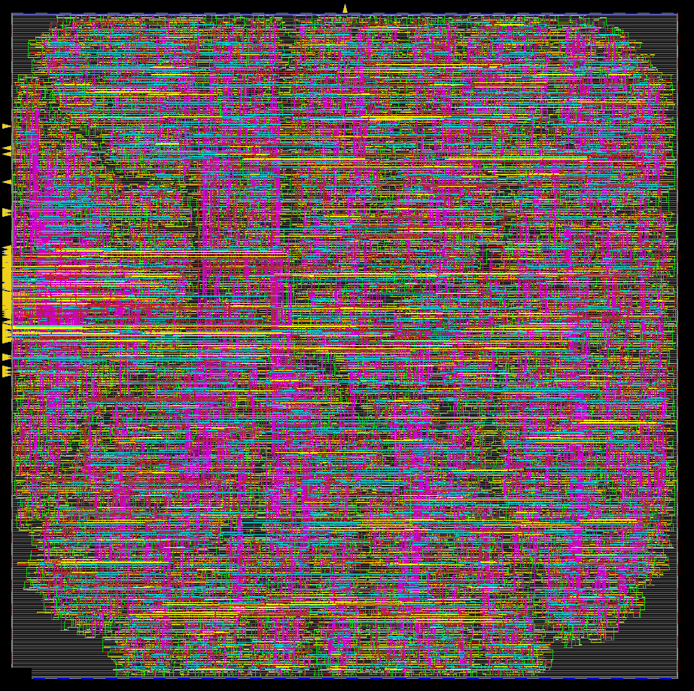
ASIC Design Example
INV
NAND2
DFF
Inputs
NOR2
XOR2
MUX2:1
Outputs
AOI21
DFF
DFF
OAI21
INV
NOR2
XOR2
INV

Slide 3
RTL – GDS FLOW
Standard Cell Library (schematic, layout, symbol, abstract)
Cadence Virtuoso
Design Specification
Project 1
No
Project 3
Behavioral Description (.v)
DRC/ LVS
Clean?
Yes
Parasitic Extraction (.sp)
Mentor Graphics Calibre
Logic Synthesis
Synopsys DesignVision
Project 4 - 5
Yes
Abstract View (.lef)
Library Characterization (.lib)
Synopsys PrimeLib
Project 2
Synthesized Gate Level Netlist (.v)
Library Compilation(.db)
Synopsys LC Shell
Automatic Place and Route
Cadence Innovus
Project 6
Final Design Verification (.gds/ .def)
Cadence Virtuoso

Slide 4
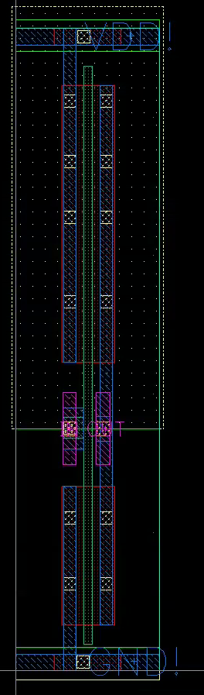
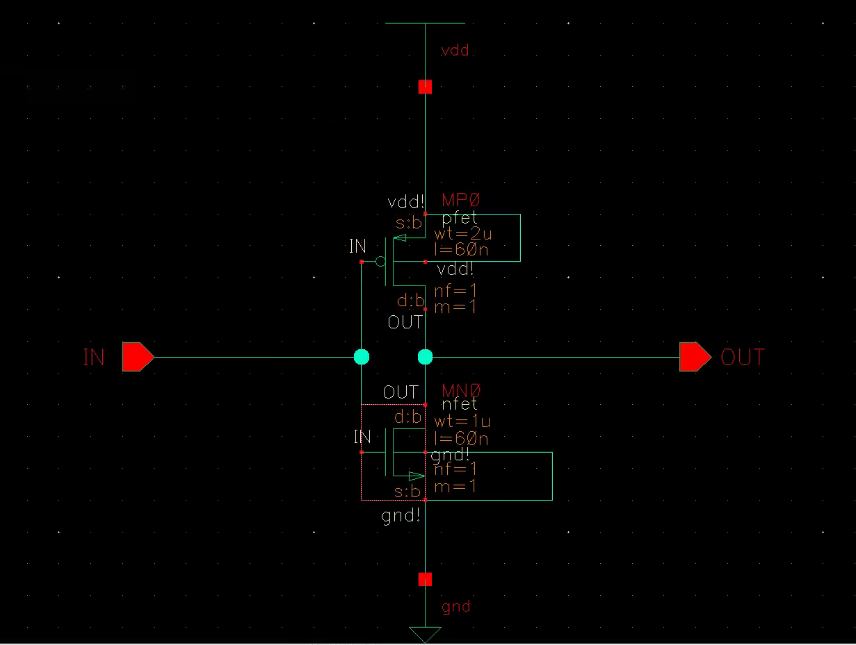
Inverter Design Demo
Layout
Schematic

Slide 5
Layout
Layers
NW: n-well
RX: Diffusion (vertical measurements of pMOS and nMOS are Wp and Wn
respectively)
JX: N+ source or drain implant area
JZ: P+ source or drain implant area
PC: Poly (horizontal measurement of PC layer is the length of the channel, L)
CA: Contact (used to connect RX and M1, also PC and M1)
M1: Metal 1 (used for routing inside the standard cell, VDD and GND pins are on M1)
M2: Metal 2 (all I/O pins are on M2 layer)
V1: Via 1 (used to connect M1 and M2)

Slide 6
Pin Pitch and Offset
INV
NAND2
DFF
VDD!
VDD!
VDD!
Offset
Pin Pitch
(W)*n
(W)*n
IN
OUT
A
B
OUT
CLK
D
R
Q
(W)*n
(W)*n
(W)*n
(W)*n
(W)*n
(W)*n
(W/2)+(W*n)
(W/2)+(W*n)
(W/2)+(W*n)
(W/2)+(W*n)
(W/2)+(W*n)
(W/2)+(W*n)
GND!
GND!
GND!
The pin pitch should be (0.26*n), meaning it can be 0.26, 0.52, 0.78...
The offset should be (0.13 + 0.26*n), meaning it can be 0.13, 0.39, 0.65...

